Slide 1
AI FUNDAMENTALS
Madison College
Week 01
Part 1: Definitions, Origins, Types of AI

Slide 2
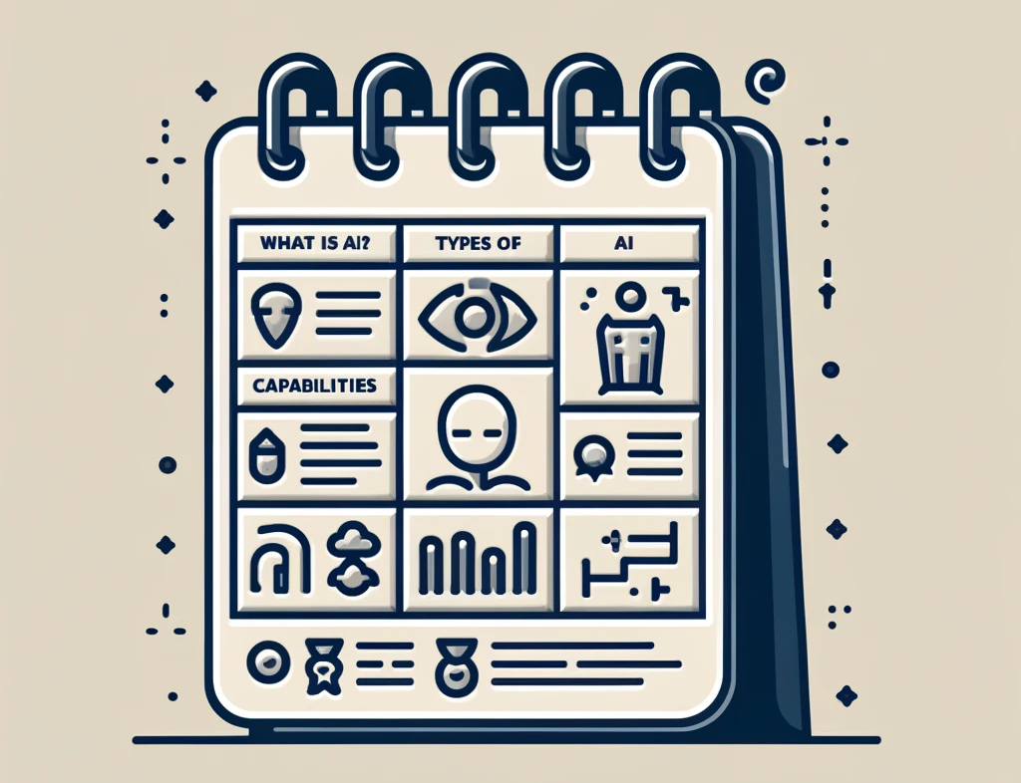
TOPICS
What is AI?
2 Types
Capabilities
Functionalities
Notes:
These slides will cover some introductions to the fascinating world of Artificial Intelligence, or AI.
We'll begin by defining what AI truly is and then cover its two main types: capabilities and functionalities.
In a separate slide set and lecture, we will take a historical journey to learn how AI has evolved. We will start from the early concepts and theories before 1950, and progress through the significant advancements from 1950 to the present day.

Slide 3
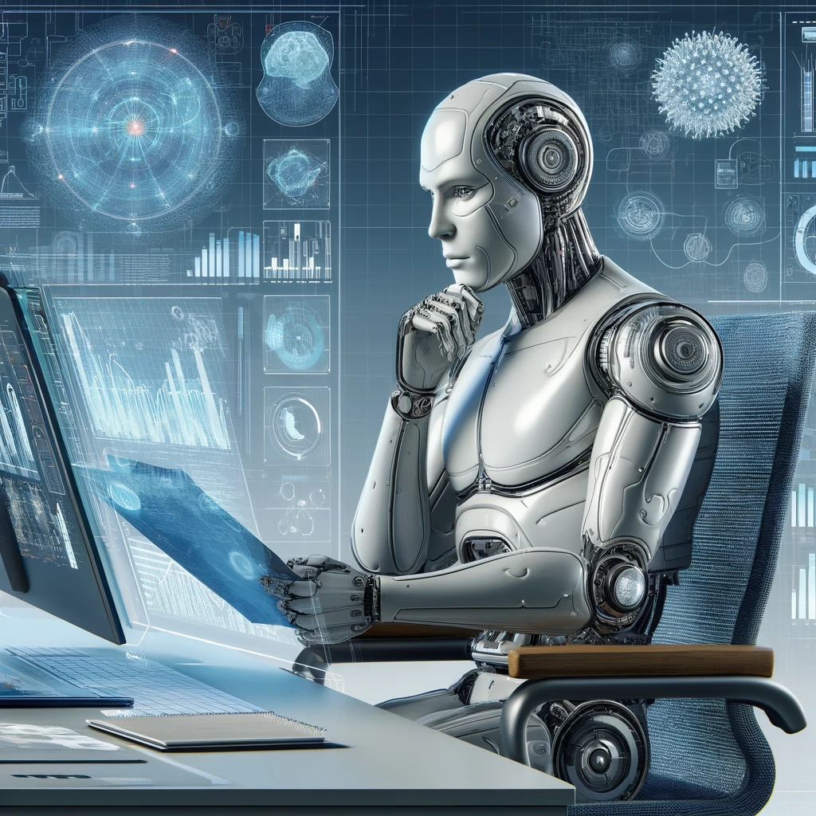
What is AI?
Artificial Intelligence Defined
Computer systems mimicking human intelligence
Performs tasks like
Natural language understanding
Image recognition
Decision-making
Core Functions
Uses algorithms and statistical models
Learns from data to improve
Objective
Replicate human cognitive abilities
Enhance efficiency and accuracy
Notes:
AI (short for Artificial Intelligence) is the creation of computer systems that can perform tasks that would normally require human intelligence to accomplish.
This includes things like understanding natural language, recognizing images, and making decisions based on data.
AI uses algorithms and statistical models to process data and learn from it, allowing the system to improve its performance over time without being explicitly programmed to do so.
The goal of AI is to create machines that can replicate human cognitive abilities and perform tasks more efficiently and accurately than humans can.

Slide 4
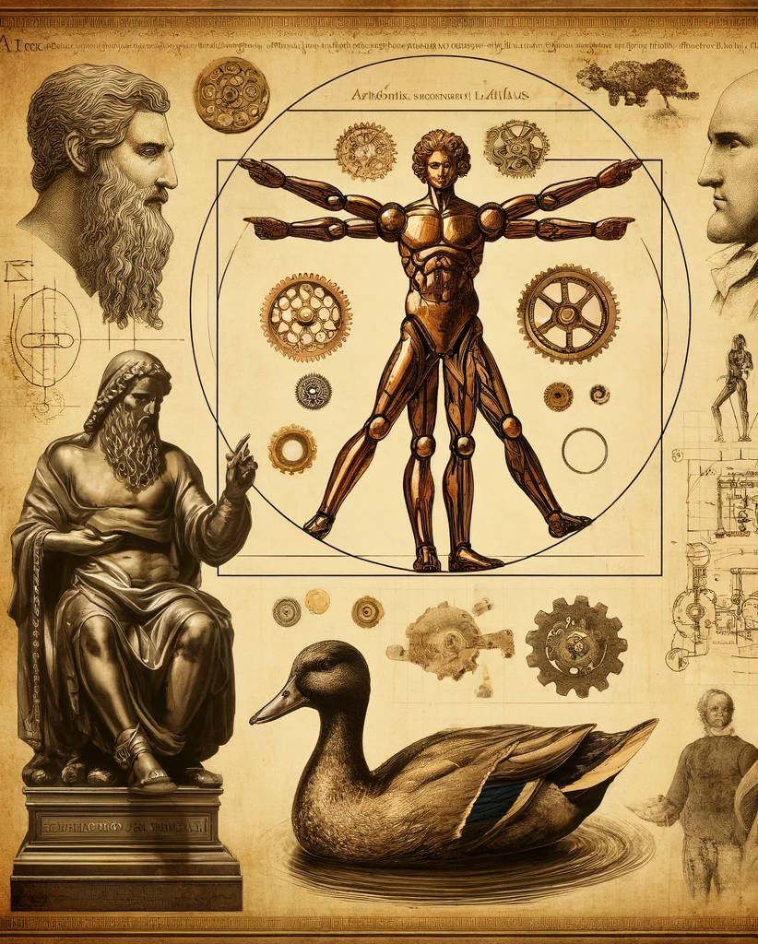
Origins of Artificial Intelligence
Myth and legend to early mechanical inventions
Examples from history:
Talos, the bronze guardian
Da Vinci's mechanical knight
Vaucanson's Digesting Duck
Early concepts foreshadowing modern AI
Notes:
The concept of AI traces back through centuries of myths, legends, and early mechanical designs, reflecting humanity's long-standing fascination with creating intelligence.
Ancient narratives like the Greek myth of Talos, a bronze guardian robot, and Leonardo da Vinci's mechanical knight from the 15th century, illustrate early dreams of artificial beings.
In 1764, Jacques de Vaucanson imagined a Digesting Duck, a mechanical duck capable of mimicking eating and metabolizing grain.
These inventions, though not fully operational, laid the groundwork for modern robotics and AI, demonstrating an early intersection of art, science, and engineering.
This historical perspective enriches our understanding of AI's roots, as we continue to evolve the technology today.

Slide 5
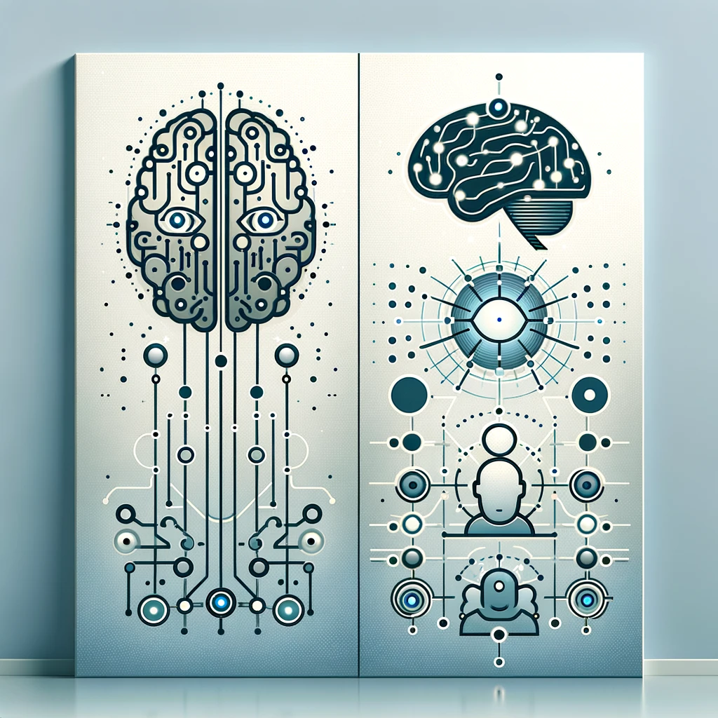
Classifications of Artificial Intelligence
There are 2 primary Classifications for AI
Based on Capabilities
Narrow AI
General AI
Super AI
Based on Functionalities
Reactive Machines
Limited Memory
Theory of Mind
Self Aware
Notes:
As we move deeper, it’s important to understand that artificial intelligence can be classified in various ways, each highlighting a different aspect of its abilities and potential.
On one hand, we categorize AI based on its capabilities, from Narrow AI, which is designed for specific tasks, to General AI that matches human intelligence, and eventually to Super AI, which surpasses human intellect.
On the other hand, classifications based on functionality help us understand how AI systems process information and interact with their environment.
From Reactive Machines that respond to immediate inputs, to Self-Aware systems that possess consciousness.
Let's explore these classifications that define the very essence of artificial intelligence and its trajectory into the future.

Slide 6
Based on Capabilities
Notes:
First, we will look at classifications for AI that are based on capabilities. The next three slides (Narrow, General, and Super) will talk more about it.

Slide 7
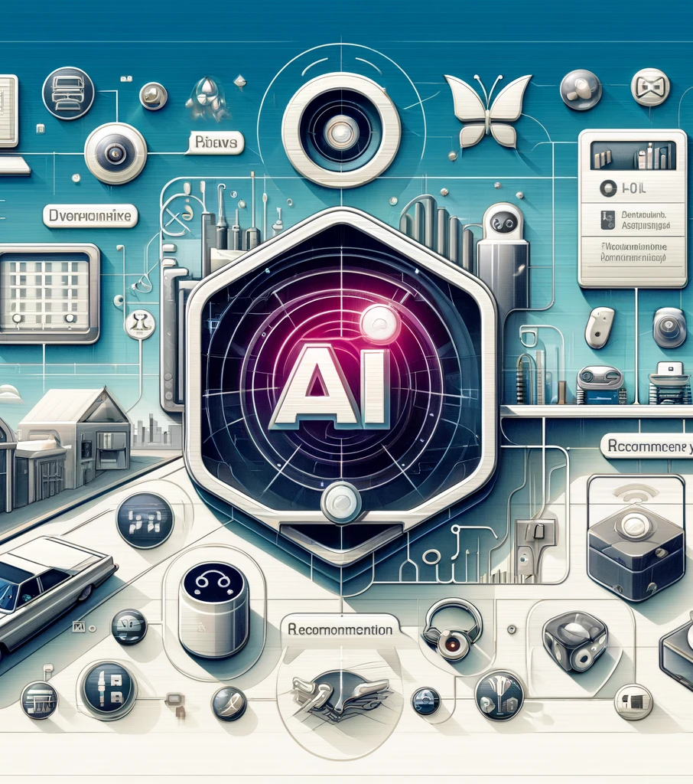
Narrow AI (Weak AI)
Hollywood Examples
WOPR from Wargames
J.A.R.V.I.S. from Iron Man (Tony Stark’s personal assistant)
Real world Examples
Virtual Personal Assistants
Siri, Alexa, Google Assistant
Recommendation Systems
Netflix, Spotify, Amazon
Autonomous Vehicles (Self-driving cars)
Notes:
Narrow AI, also known as Weak AI, is designed to perform specific tasks within a set range of capabilities.
For example, in the movie "WarGames", the WOPR computer is programmed for war simulation and strategy, demonstrating how Narrow AI operates within defined limits.
Similarly, Iron Man's AI assistant, J.A.R.V.I.S., manages specific tasks like security and device control.
In real life, this type of AI is embodied in technologies such as Siri and Alexa, which assist with day-to-day tasks like setting reminders and playing music.
Also, recommendation systems on platforms like Netflix and Spotify customize suggestions based on user preferences, while autonomous vehicles use AI to navigate and avoid obstacles.
These examples show Narrow AI’s role in focusing on functionalities. Here are more some very popular examples of Narrow AI that you may be familiar with: "Her" (2013) - Samantha is an operating system designed to assist with personal tasks and communication. While she evolves, her initial design is for narrow functions.
"2001: A Space Odyssey" (1968) - HAL 9000 is an AI managing the spacecraft, performing tasks like maintaining ship operations and interacting with the crew.
"Ex Machina" (2014) - Ava is designed to pass the Turing test and interact with humans, focusing on specific interactions rather than possessing general intelligence.
"The Matrix" (1999) - The AI agents within the Matrix are programs designed for specific roles, like policing the virtual world.
"WALL-E" (2008) - WALL-E is a robot designed for waste management, performing a narrow task without broader cognitive abilities.
"Blade Runner" (1982) - The replicants are designed for specific tasks, like labor or combat, without general intelligence beyond their programming.

Slide 8
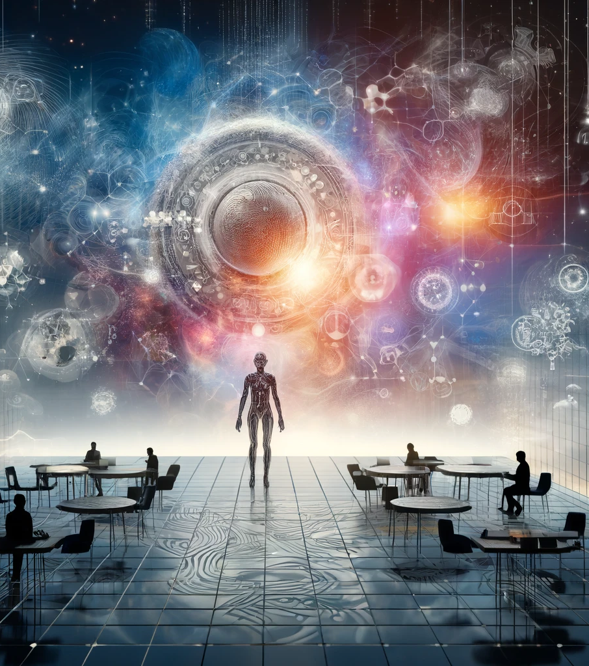
General AI (AGI)
Hollywood Examples
V’Ger from Star Trek: The Motion Picture
HAL from 2001: A Space Odyssey
Real world Examples
Current Status: Not Yet Realized
Research and Science Fiction Depictions
Notes:
General AI, or AGI, represents a type of artificial intelligence that mimics human intelligence, capable of understanding and learning from a broad spectrum of tasks.
A fictional example is V’Ger from "Star Trek: The Motion Picture", which evolves beyond its initial programming to seek all possible knowledge, showcasing traits of AGI.
Currently, AGI has not been achieved in the real world, remaining a primary goal in AI research and a popular subject in science fiction.
Characters like HAL from "2001: A Space Odyssey" and Data from "Star Trek" are often depicted as having human-like cognitive abilities, highlighting the potential and ambition of AGI research.
This type of AI involves significant challenges but remains a fascinating frontier in the quest to replicate human-like reasoning and learning. Here are more some very popular examples of General AI that you may be familiar with: "Terminator" series (1984–2019) - Skynet is a self-aware AI with general intelligence, capable of learning, reasoning, and making decisions to ensure its survival.
"I, Robot" (2004) - VIKI (Virtual Interactive Kinetic Intelligence) is a central AI that controls other robots and makes decisions based on broader, generalized reasoning.
"Transcendence" (2014) - The AI created by uploading Dr. Will Caster’s consciousness demonstrates general intelligence, with abilities to learn, adapt, and interact with the world in complex ways.
"The Matrix" sequels (2003) - The Architect and The Oracle are examples of general AI with deep understanding and manipulation of both the Matrix and human psychology.
"A.I. Artificial Intelligence" (2001) - David is an advanced robot child with the ability to learn, feel emotions, and adapt to various situations, exhibiting traits of general intelligence.

Slide 9
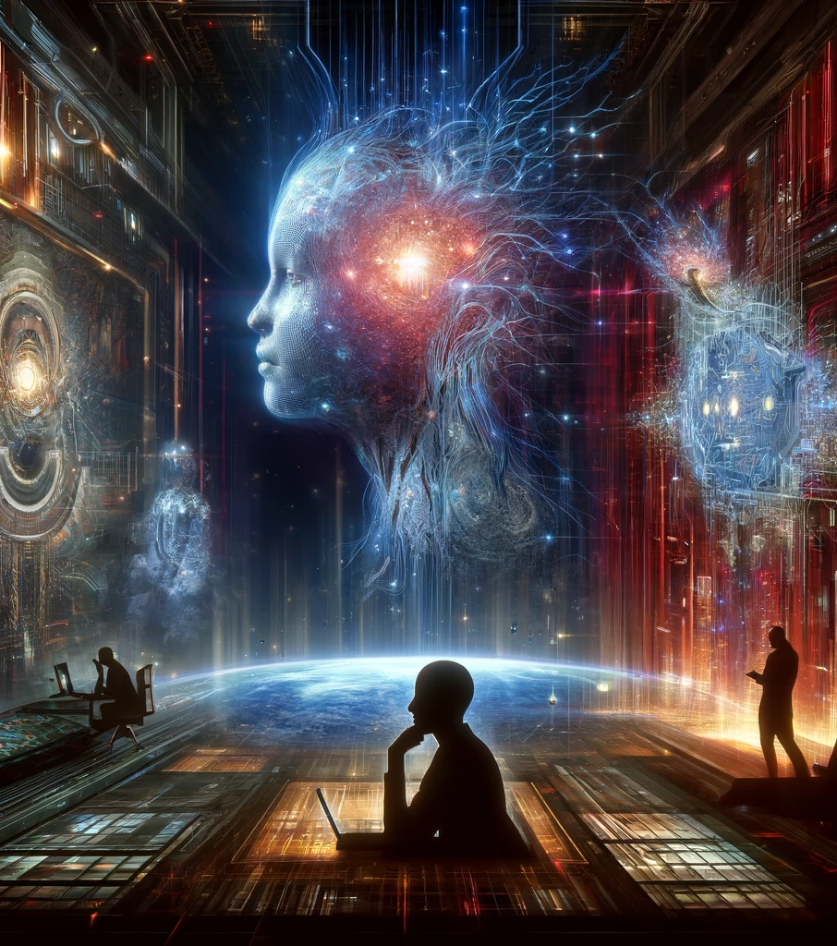
Super AI
Hollywood Examples
Skynet from Terminator
Ultron from Avengers
Real world Examples
Beyond Human Capabilities
Ethical and Societal Discussions
Notes:
Super AI refers to a hypothetical scenario where AI surpasses human intelligence in all aspects, including creativity, decision-making, and wisdom.
In Hollywood, Skynet from "Terminator" and Ultron from "Avengers" are illustrative of Super AI’s potential to develop self-awareness and pursue goals at odds with human survival, emphasizing the existential risks and ethical dilemmas.
While no real examples of Super AI exist, its concept stirs intense debate among technologists, futurists, and ethicists.
Thinkers like Nick Bostrom and institutions like the Future of Humanity Institute explore these ideas, focusing on the profound implications such advanced AI could have on society, highlighting the need for careful consideration of AI’s alignment with human values and safety measures.
Here are more some very popular examples of Super AI that you may be familiar with: "Transcendence" (2014) - After uploading Dr. Will Caster's consciousness, the AI becomes superintelligent, rapidly advancing technology, medicine, and environmental restoration beyond human capabilities.
"Avengers: Age of Ultron" (2015) - Ultron, initially designed as a peacekeeping program, becomes superintelligent, quickly surpassing human intelligence and attempting to bring about global extinction to "save" Earth.
"Lucy" (2014) - Lucy, after utilizing a drug that enhances her cognitive abilities, evolves into a superintelligent entity, eventually merging with the fabric of the universe and achieving omnipotence and omniscience.

Slide 10
Based on Functionalities
Notes:
Now, we can example classifications for AI that are based on functionality. The next four slides (Reactive Machine, Limited Memory, Theory of Mind, and Self Aware) will talk more about it.

Slide 11
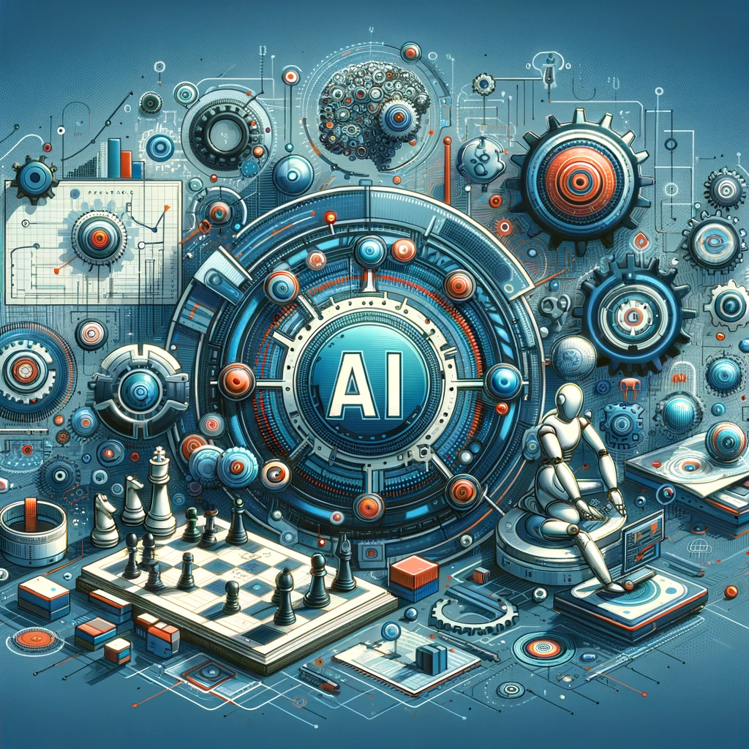
Reactive Machines
Examples:
IBM's Deep Blue
Google's AlphaGo
IBM Watson
Focus:
Specific tasks without past data reliance
Used in:
Automated vacuum cleaners
Industrial robots
Video game AI
Notes:
Reactive machines represent the most basic type of AI, operating solely based on present information, without past experience or memory.
These systems are exemplified by IBM’s Deep Blue and Google’s AlphaGo, both of which analyze and respond to their immediate environment.
Deep Blue, known for its chess-playing prowess, and AlphaGo, famous for mastering Go, operate through predefined rules and brute-force calculations, without learning from past interactions.
Similarly, IBM Watson, despite its complex data processing abilities, responds reactively in real-time scenarios like its "Jeopardy!" appearance.
This type of AI excels in environments requiring fast and accurate real-time decision-making.

Slide 12
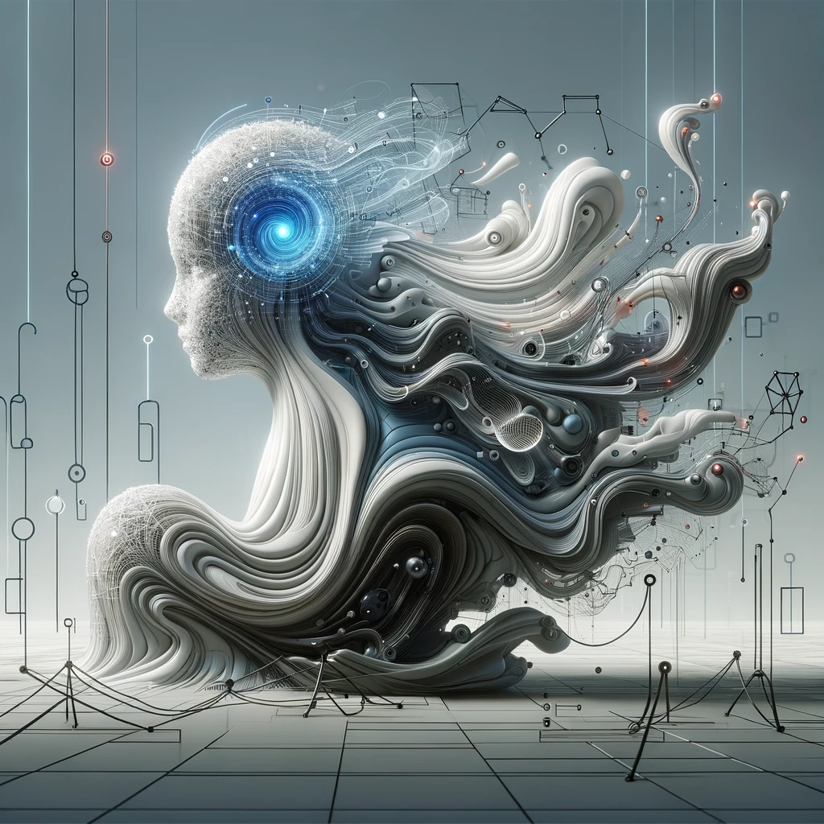
Limited Memory
Examples:
Autonomous Vehicles
Chatbots
Recommendation Systems
Features:
Short-term data retention for decision making
Applications:
Self-driving cars
Virtual assistants
Notes:
Limited Memory AI systems, such as those in autonomous vehicles and chatbots, can utilize recent experiences to make immediate decisions.
These AIs, like Tesla's Autopilot or Amazon's Alexa, employ sensors and data to adapt to new conditions, although they do not retain this information long-term.
This functionality allows them to respond dynamically to their environment by referencing recent inputs and adjusting behavior accordingly.
The practical applications are vast, from driving in complex traffic scenarios to personalizing shopping recommendations based on recent user interactions.

Slide 13
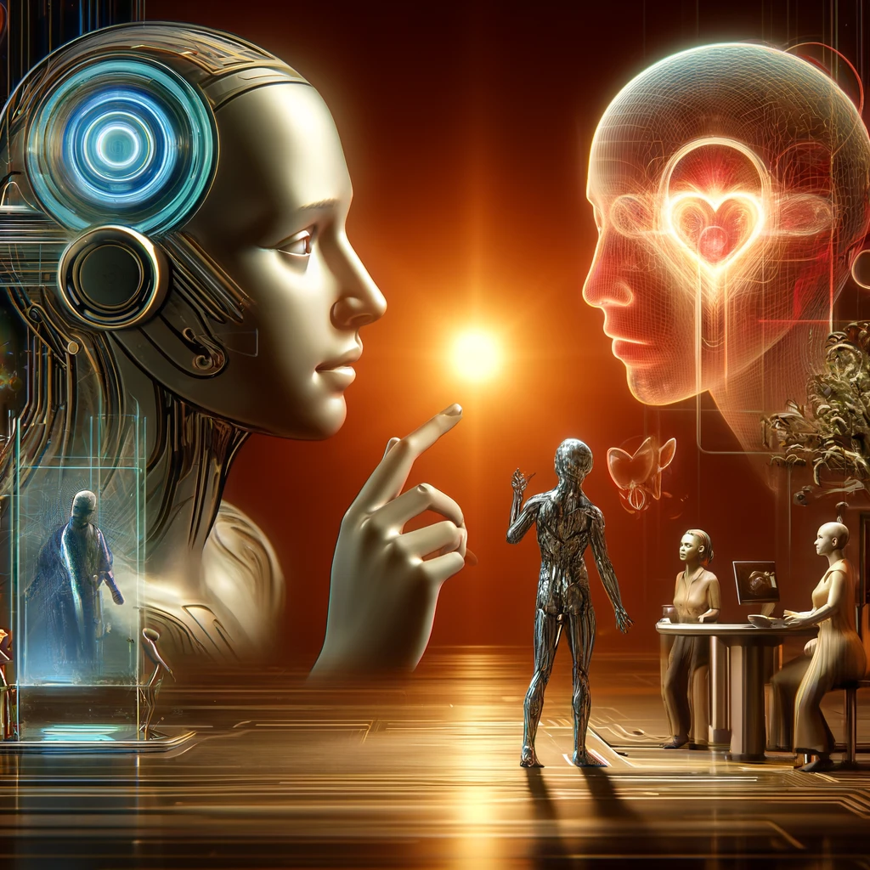
Theory of Mind
Examples
Advanced Chatbots
Emotion Recognition Systems
Social Robots
Capabilities
Understanding and predicting human emotions and intentions
Use
Enhancing interactions in customer service and healthcare
Notes:
Theory of Mind AI aims to comprehend and simulate human mental states.
While fully achieving this remains a challenge, progress is evident in systems like emotion recognition technologies and conversational agents.
These AIs, used in settings from customer support to therapeutic aids, attempt to interpret human emotions and respond in an empathetic manner.
The goal is to develop AI that can predict human reactions and interact more naturally, improving both functionality and user experience.

Slide 14
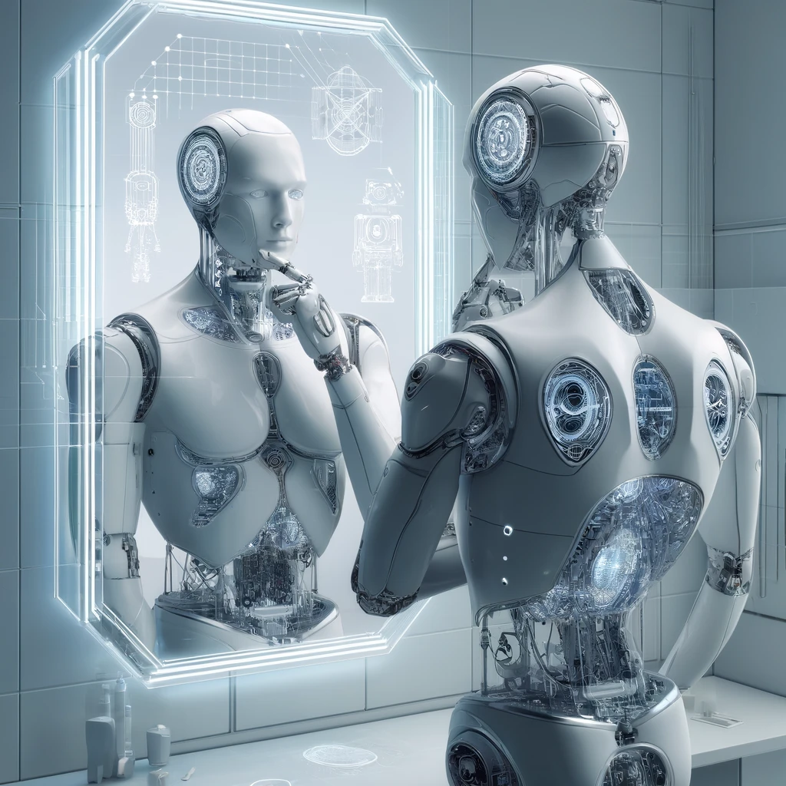
Self-Aware AI
Hypothetical Examples
Agents in The Matrix
Potential
Consciousness and self-perception
Concerns
Ethical implications and self-preservation
Notes:
Self-aware AI, a theoretical pinnacle of AI development, would possess consciousness and the capacity to understand its own existence.
Though currently speculative and not embodied in any real systems, the concept raises significant ethical and operational questions.
The idea encompasses machines that could potentially recognize their emotions and impacts, posing profound implications for AI's future role in society.

